Slide 1
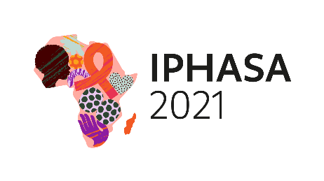
Sustainable Health Insurance Scheme, to Mitigate the Impact of ‘User Fees’ on Households of Children Living with HIV: Experience of USAID Funded ICHSSA 2 Project in Lagos State, Nigeria
Authors: Iwuala Felix¹, Oke Olufemi¹, Doreen Magaji², Moses Katbi², Sontyo Jimin¹, Lannap Faith¹, Ayeni Olugbenga, Ogunmodede Matthew¹, Folorunso Ebenezer¹, Adiebonye Fubara¹ Idoko Elijah³
1. ICHSSA 2 Project, ARFH, Lagos State,
^{2. USAID/Nigeria, Abuja,}
^{3. Project HOPE Nigeria}
Background
HIV infected households face myriad of challenges including economic and health-related issues, due to various vulnerability factors that threaten their resiliency and ability to cater for basic needs of Children Living with HIV/AIDS (CLHIV). HIV depletes household resources and limits access to comprehensive health services, due to ‘user fees’ payable at the facilities. As part of Journey to Self-Reliance (J2SR), ‘user fees’ have been eliminated for CLHIV Households with support from United States Agency for International Development (USAID) and Lagos State Government.
Description
The Association for Reproductive and Family Health (ARFH) is implementing the Integrated Child Health and Social Services Award, Region 2 (ICHSSA-2), to mitigate the impact of HIV/AIDS on vulnerable children (0-<18years) and their Households in Lagos State, with support from USAID. To ensure seamless access to comprehensive health services, CLHIV households on ICHSSA 2 Project have been enrolled on the Lagos State Government Health Insurance Scheme (‘ILERA-EKO’), being implemented by the Lagos State Health Management Agency (LASHMA). A major provision of the Scheme is to grant waivers to eligible vulnerable individuals, to benefit from free health services under the Social Equity Fund.
Lesson Learned
The ICHSSA 2 Project, through sustained advocacy visits, which culminated in the mutual endorsement of Partnership Agreement with LASHMA, received waiver for a total of 2493 most vulnerable beneficiaries (Caregivers 706 [M- 79; F-627] and Children 1787 [ M- 931; F-856]) Enrolled beneficiaries will continue to access free comprehensive health services even beyond the project tenure at the expense of Lagos State Government, in line with J2SR. The beneficiaries have received orientation and linked to Health facilities in their Communities and close to where they reside, for uninterrupted access to services.
Conclusion/Next Steps
The elimination of ‘user fees’ has been achieved for vulnerable CLHIV households for the treatment of ailments, including surgeries and deliveries in Health Facilities, thereby reducing patronage of Traditional Birth Attendants (TBA), Morbidity and Mortality rates. More beneficiaries will be enrolled on the Health Insurance Scheme, for improved treatment outcome and supported with Household Economic Strengthening (HES) interventions, to promote adherence to ART, Retention and sustained Viral Load Suppression.
PRESENTED AT IPHASA 2021 – the 1st International Paediatric HIV Symposium in Africa|17-18 November 2021

