Slide 1
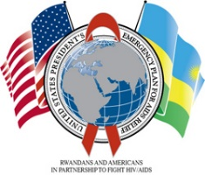
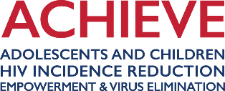
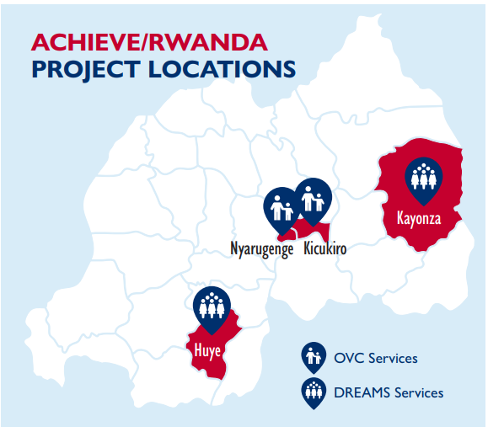
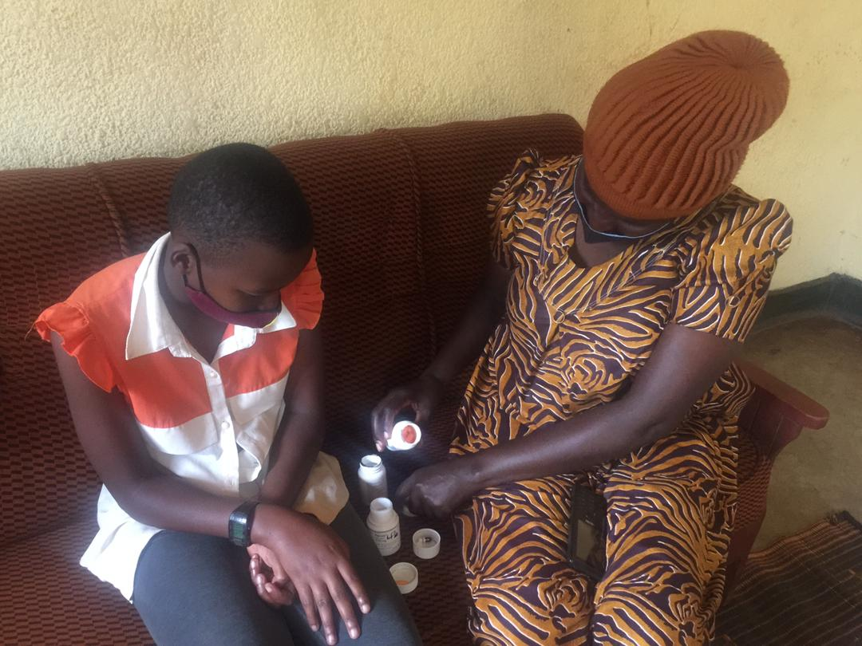
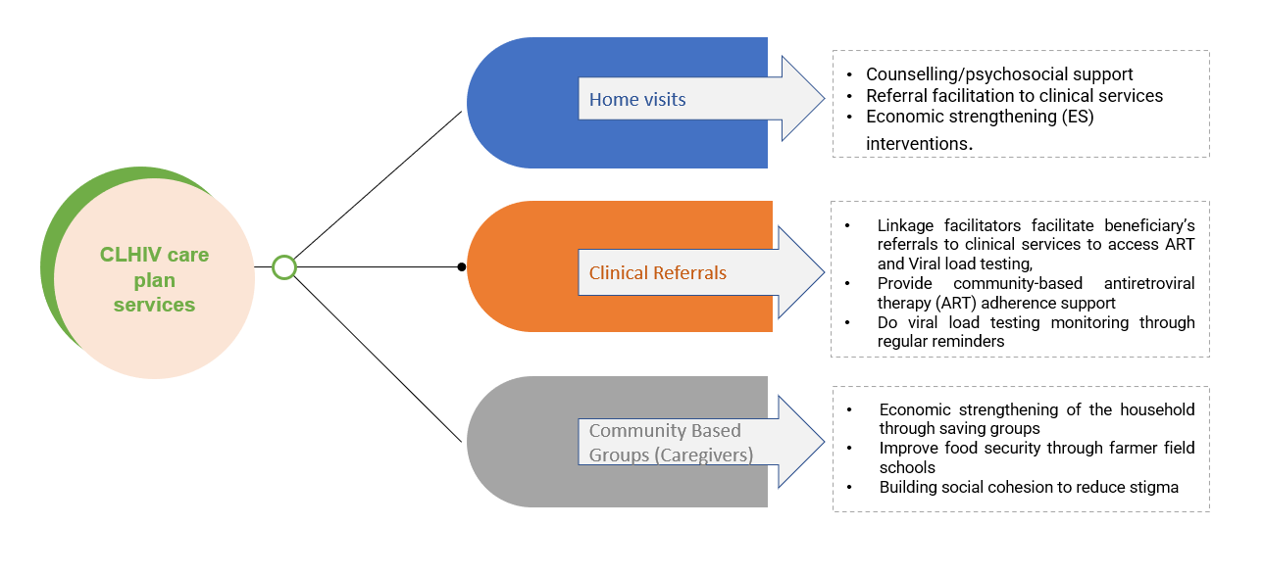
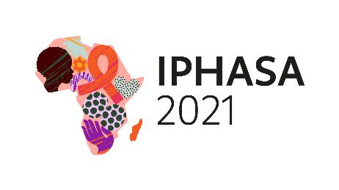
Holistic Care for Children living with HIV: ACHIEVE Rwanda Project’s Experience
Authors: Mugwaneza Placidie, Mutabazi Moise, Muramira Absolom, Kaberuka Teddy, Muhayimpundu Ribakare, Erica Kuhlik, Sarah Sadiq, Tom Ventimiglia
Background
The USAID/PEPFAR-funded Adolescents and Children, HIV Incidence Reduction, Empowerment, and Virus Elimination project (ACHIEVE) Rwanda project implements orphans and other vulnerable children (OVC) and DREAMS activities in four targeted districts to reduce vulnerability and HIV incidence while contributing towards HIV epidemic control. ACHIEVE Rwanda project is community-based and provides comprehensive interventions to beneficiaries through direct services delivery and referrals to different services providers in the community and health facilities.
The ACHIEVE OVC comprehensive program component is implemented in two districts, Huye and Kayonza, and aims to optimize access to HIV prevention and treatment services and to address socio-economic challenges faced by children living with HIV (CLHIV).
Description
ACHIEVE Rwanda collaborates with the Ministry of Health (MOH), the Rwanda Biomedical Center (RBC), health facilities and the Rwandan network of people living with HIV (RRP+) to identify and enroll CLHIV and their caregivers and provide them with OVC comprehensive services.
The project targets CLHIV, children of HIV-positive caregivers, HIV-Exposed Infants, children of female sex workers and survivors of sexual gender-based violence.
Using a case management approach, ACHIEVE Rwanda’s case management volunteers (CMVs) conducted a risk and vulnerability assessment (RVA) for the enrolled beneficiaries. The assessment revealed multidimensional needs for CLHIV as shown in Figure 1 below: the top three were economic strengthening of CLHIV families (88.2%), education support (46.5%) and psychosocial support and counselling (26.9%).
Figure 1: Identified needs for CLHIV under 15 years and their caregivers, RVA findings, May 2021
The RVA findings informed the development by CMVs of individual care plans which listed the required services/interventions as shown in the diagram below.
Since then, CMVs have been conducting bi-weekly home visits to deliver tailored OVC comprehensive services to the beneficiaries guided by their care plans while clinical linkage facilitators have been supporting beneficiaries to access clinical services at the health facilities as also illustrated in Figure 2 below.
Figure 2: OVC Comprehensive Services
ACHIEVE Rwanda deliver comprehensive interventions to CLHIV in order to:
    Ensure that they adhere to antiretroviral (ARV) treatment and are virally suppressed;
    Remain in school; and
    Live in families who are economically strengthened to become resilient.
Lessons learned
ACHIEVE Rwanda identified and enrolled 368 CLHIV (under 15) between November and December 2020.
Between October 2020 and September 2021, ACHIEVE supported CLHIV and their families through:
  School subsidies for all 368 CLHIV;
  Creation of savings groups for 79.2% of caregivers; and
  Cash transfers for families of all 368 CLHIV.
Through these economic strengthening and educational interventions, the project reported regular school attendance for all 368 supported CLHIV and improved their families' financial situation.
Existence of signed Memorandum of Understanding (MoU) with all health facilities, engagement with community clinical linkage facilitators, close collaboration with health facilities combined with the community case management approach, contributed to good ART adherence among CLHIV supported by ACHIEVE project where 93% are virally suppressed, as shown in Figure 3 below.
Figure 3: Viral Load Cascade for Children under 15
(October 2020- Sept. 2021)
Conclusions
ACHIEVE Rwanda has a holistic approach – combination of health, economic and social interventions - that address the multi-dimensional needs of CLHIV and their families.
Stakeholders’ engagement and involvement of community-based volunteers improves linkages, ART adherence and retention.
ACHIEVE Rwanda project’s complementary interventions contributed to improving the health, wellbeing, and resilience of OVC and their families.
15-year-old CLHIV (on the left) supported by ACHIEVE Rwanda receives her treatment prepared by her caregiver (on the right) in their home in Kayonza district, in September 2021.
PRESENTED AT IPHASA 2021 – the 1st International Paediatric HIV Symposium in Africa|17-18 November 2021

