Slide 1
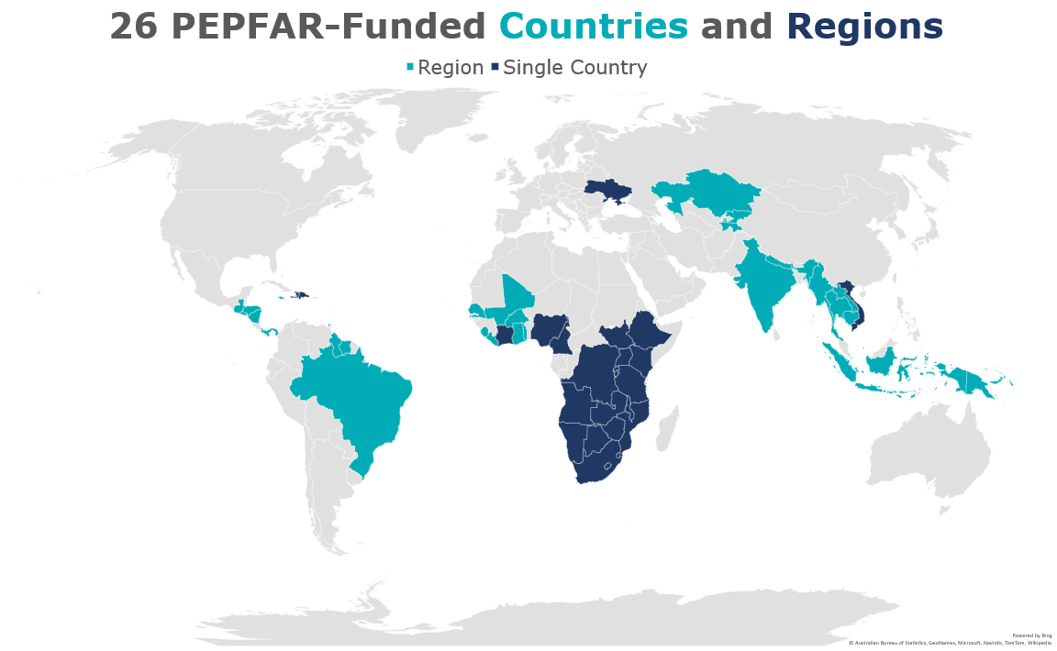
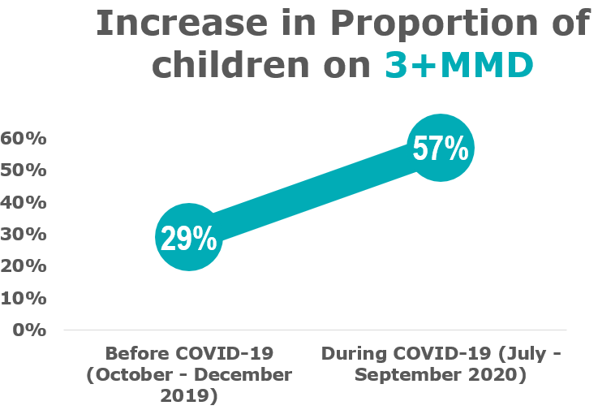
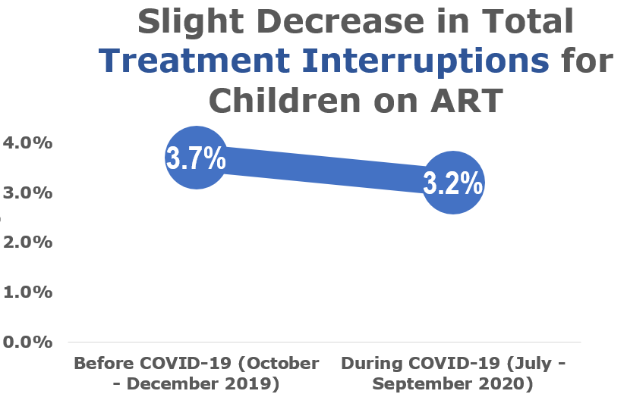
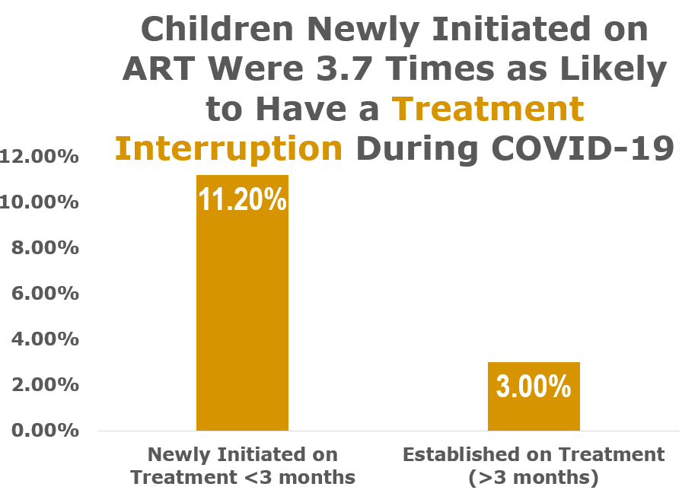
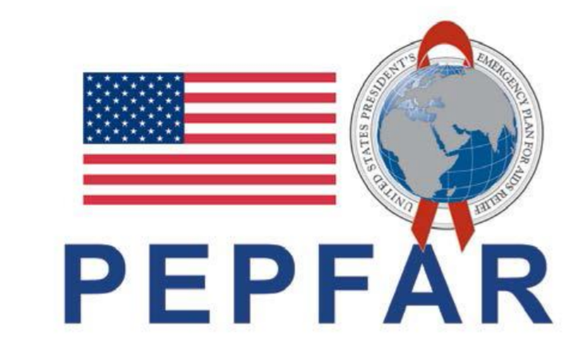
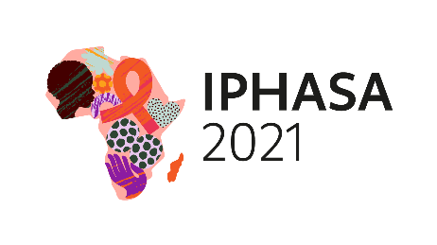
Rapid Increase in Multi-Month Dispensation of ART, with Little Pediatric Treatment Interruption Events in 26 PEPFAR-Funded Countries and Regions During the SARS-CoV-2 COVID-19 Pandemic
KaeAnne Parris, MPH¹, Marisa Hast, PhD¹, Susan Hrapcak, MD¹, Jennifer Swanson, MPH¹, Canisious Musoni, MD³, Henri Longuma, MD⁴, Prao Aka Kouame Herve, MD⁵, Chris Obanubi, MD⁶, Gurpreet Kindra, MD⁷, Reginald Jean Louis, MD ⁸, Mayer Magdalene Mange, MD, MSC, PHL⁹, CDC Pediatric Continuity of Care and Treatment/Retention Group¹⁰, Stephanie Hackett, PA-C, MPH, MMSc¹, Michelle Williams-Sherlock, MPH²
Background
Methods
Background
of children living with HIV are on life saving antiretroviral therapy¹
Preventing treatment interruptions can increase ART coverage in children. Amidst COVID-19, President’s Emergency Plan for AIDS Relief (PEPFAR)-supported countries strategically adopted policies to enable children living with HIV (CLHIV) to receive three or more months of multi-month dispensation (3+ MMD) of antiretroviral therapy (ART), to prevent treatment interruptions.
We aim to describe trends in 3+MMD and IIT during COVID-19
Analyzed monitoring and reporting indicators from CDC-supported for CLHIV (0-14 years)
Describe the percent change in 3+ MMD across 24 countries and two regions in CDC-supported sites
Describe the percent change in treatment interruptions (IIT) before (October-December 2019) and during (July-September 2020) COVID-19; IIT is the number of CLHIV with no reported clinical contact since their last expected contact of those on ART
Compare rate of treatment interruption for CLHIV newly initiated (<3 months on ART) and established on ART for ≥3 months
53%
Results
MMD data were available for 78% (n=284,773) of CLHIV before, and 85% (n=312,215) during COVID-19
There was a slight decrease in total IIT, from 3.7% to 3.2%
A greater absolute number with IIT were established CLHIV (11,078) compared with those newly initiated on ART (1,196). However, the relative risk of IIT for newly initiated is 3.7 times higher that of more established CLHIV.
Advocacy for uptake and implementation of policies supporting MMD for children may have helped to prevent an increase in total IIT during COVID-19, particularly among newly initiating children.
Public and private-partnership will and concerted efforts are required to advance MMD implementation and other strategies to promote adherence and mitigate losses among CLHIV during and after the pandemic.
Conclusion
Footnotes
¹ UNAIDS. Joint United Nations Programme on HIV/AIDS, 2021
Questions:
KaeAnne Parris, MPH kaparris@cdc.gov
PRESENTED AT IPHASA 2021 – the 1st International Paediatric HIV Symposium in Africa|17-18 November 2021

