Slide 1
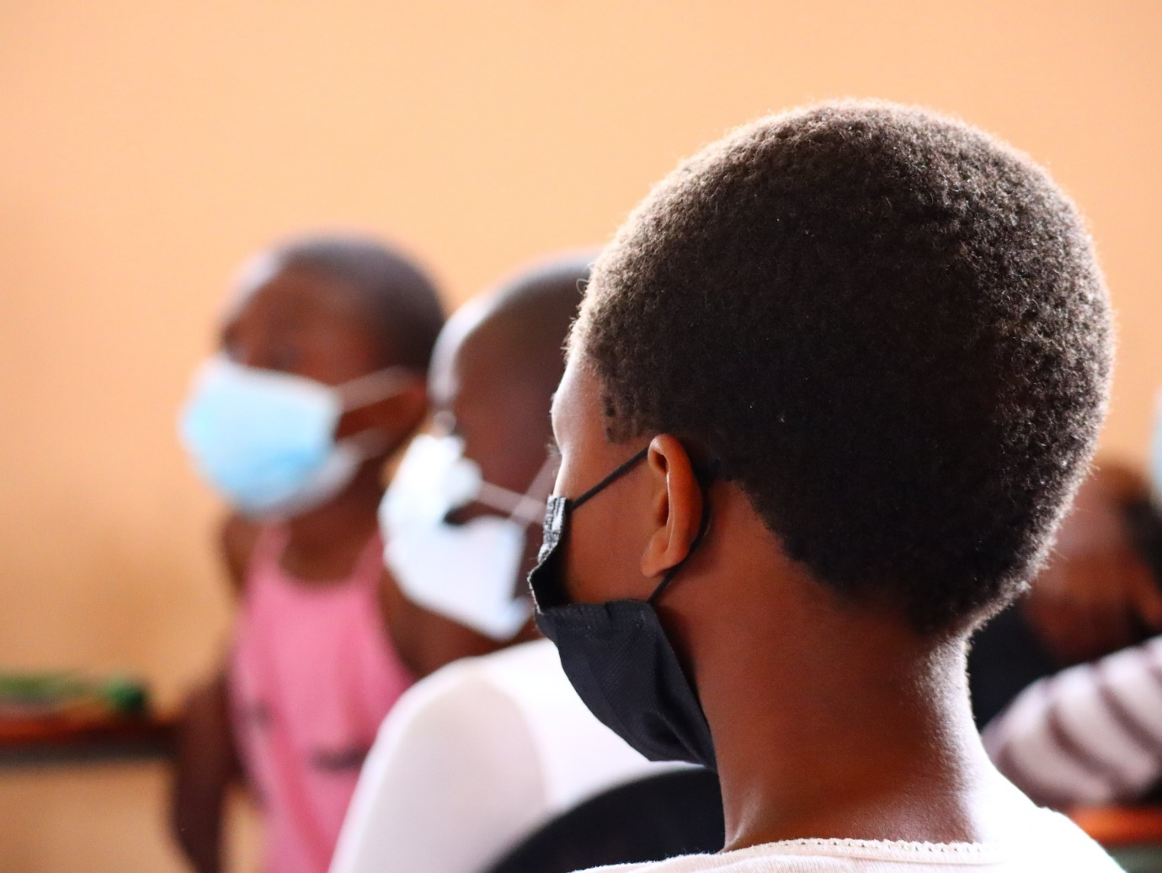
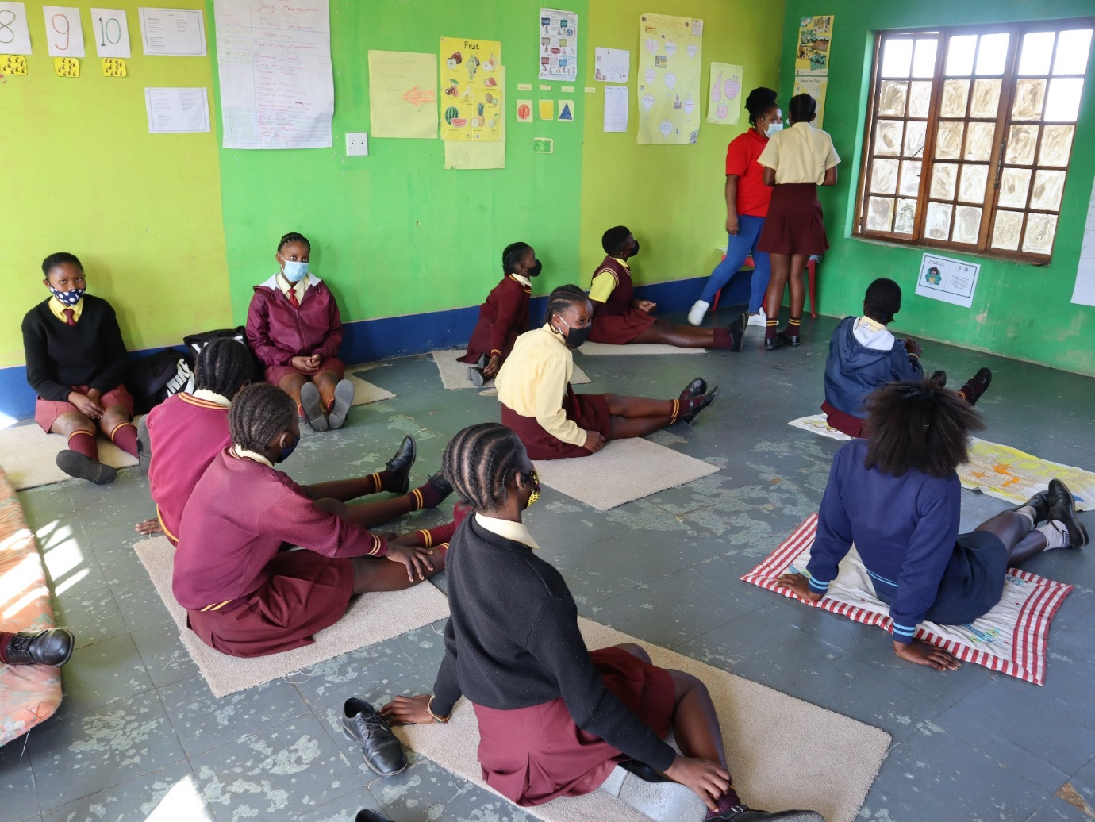
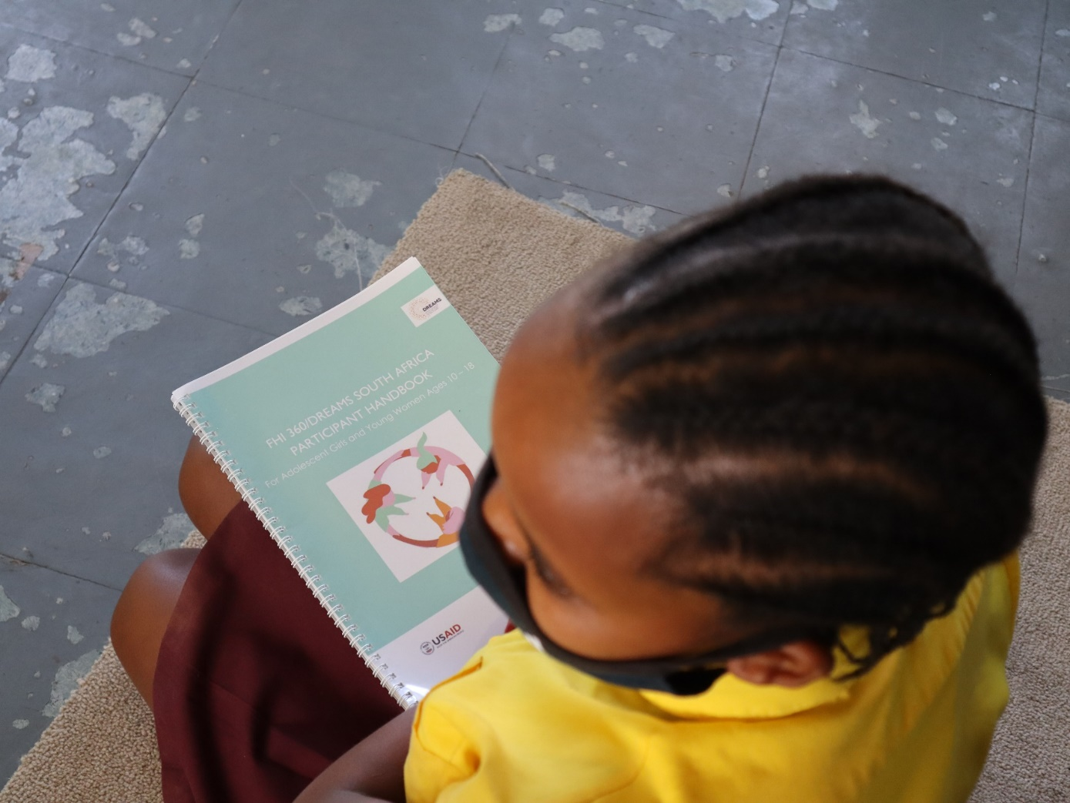
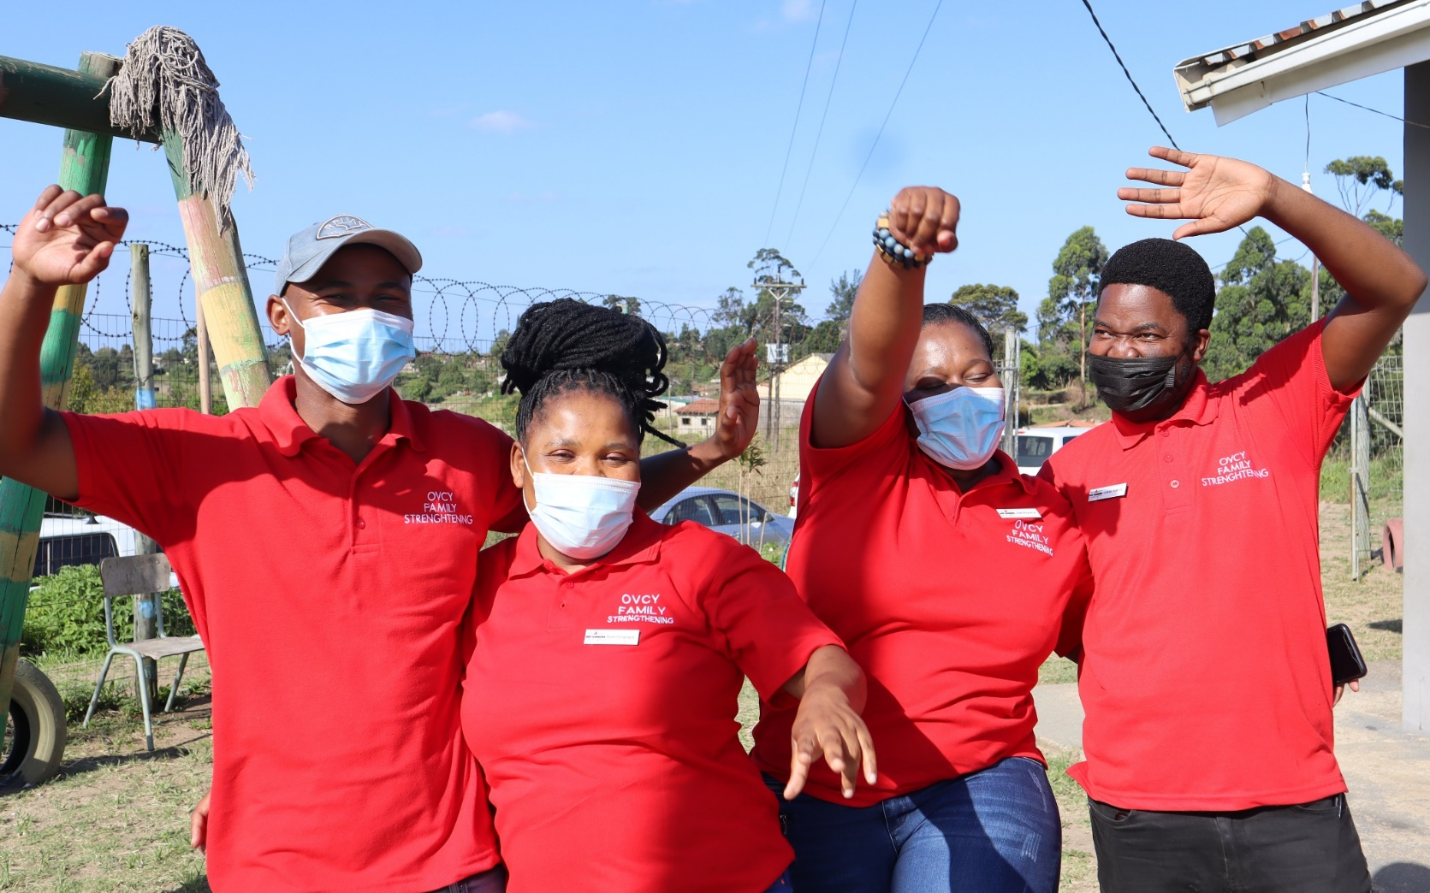
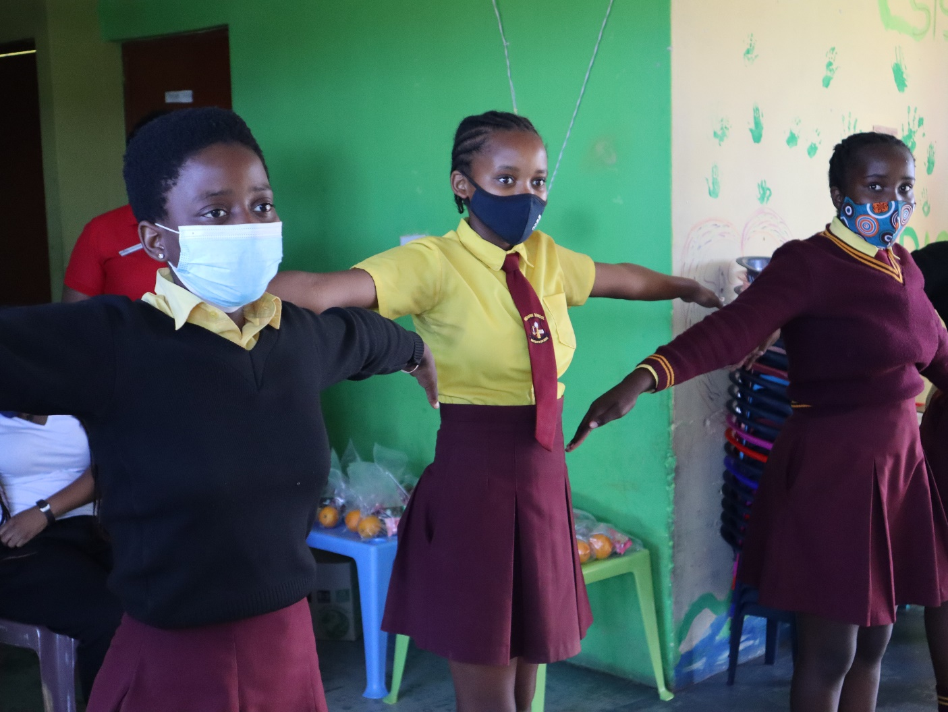
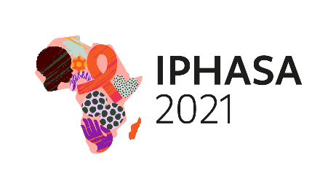
Enablers and barriers to viral load suppression among orphans and vulnerable children and adolescents living with HIV in South Africa
Background
The FHI 360 PEPFAR-funded Capacity Development and Support (CDS) program implements an Orphans, Vulnerable Children, and Youth (OVCY) Family Strengthening project on behalf of USAID in South Africa
The goal of the CDS OVCY Family Strengthening project to improve the health and well-being of children and families by mitigating the impact of HIV and AIDS, increasing children’s resilience, and reducing their risk of HIV infection
The CDS OVCY Family Strengthening project also contributes to achieving the UNAIDS 95-95-95 targets by supporting vulnerable children and adolescents. This is achieved through:
Methods
C/ALHIV, aged 0 – 20 years were randomly sampled from the Community Based Information System (CBIMS)
651 C/ALHIV sampled
350 females
301 males
31% (170) were not virally suppressed
31%
69%
69% (378) were virally suppressed
Facilitating access to HIV testing services
Facilitating access to HIV treatment
Facilitating retention and care for HIV services
According to the National Institute of Communicable Diseases in South Africa, 72% of children and adolescents (0-19 years of age) with a known HIV viral load, were virally suppressed (<1000 RNA copies per ml)*
To enhance access to a differentiated package of services for children and adolescents living with HIV (C/ALHIV), there is a need to understand the enablers of and barriers to viral load suppression.
C/ALHIV in the OVCY Family Strengthening project were evaluated to understand these enablers and barriers from eight implementing partners in four provinces:
Variables included in the assessment
DEMOGRAPHIC
Age
Gender
Caregiver income
Caregiver education
Caregiver employment status
Limpopo
TREATMENT FACTORS
Gauteng
KwaZulu-Natal
Viral suppression status
Duration of C/ALHIV on treatment
ART regimen
Side-effects experienced by C/ALHIV
Frequency of viral load monitoring
Eastern Cape
*Paediatric & Adolescent HIV Viral Load Monitoring, 2014-2020-NICD December 2020
Results
Barriers to viral load suppression
Missed clinic appointments
Lack of psychosocial support
Distance to facility
Travel time to facility
Waiting times at facility
Availability of transport money
FINDINGS
RESPONSE
Enablers to viral load suppression
Caregivers administering antiretroviral therapy for children under 14 years increases the chances of the CLHIV achieving viral load suppression (P=.008)
C/ALHV are more likely to achieve viral load suppression when they and their caregivers receive psychosocial support (P<.01)
Longer waiting times in health facilities may result in missed appointments and ultimately becoming virally unsuppressed (P=.04)
C/ALHIV and caregivers who spend more than three hours in queues at health facilities are 3.5 times more likely to be virally unsuppressed
Consistent case management and frequent home visits by community care workers may promote the likeliness of C/ALHIV achieving viral suppression (P=.02)
Psychosocial Support
Social workers should work closely with community care workers to provide psychosocial support to C/AHIV and their families
Availability of transport money
Where possible, partners should provide transport to health facilities or facilitate establishment of ART pick-up points
Missed clinic appointment
Community care workers should diarize appointments and remind C/ALHIV and their caregivers of the dates
Distance to facility / ART pick-up point and waiting time at health facility
Partners should facilitate home deliveries of ART and work with relevant clinical partners to establish ART pick-up points
Community care worker support and case management
Community care workers should conduct home visits at least twice a month
Conclusion
Findings will be used to determine differentiating characteristics of C/ALHIV, for effective case management. Tailored and age-appropriate services should be prioritized to fast-track efforts towards achieving the last 95 goal among C/ALHIV in South Africa.
Acknowledgement
This publication is made possible by the generous support of the American people through the U.S. President’s Emergency Plan for AIDS relief (PEPFAR) with the United States Agency for International Development (USAID)
The contents are the responsibility of the Capacity Development and Support program, managed by FHI 360, and do not necessarily reflect the views of USAID or the United States Government.
Authors
C. Siame, C. Magezi, N. Nyoni, S. Enslin
Contact us
Visit our website at www.capacitydev.org or email us at cds@fhi360.org
PRESENTED AT IPHASA 2021 – the 1st International Paediatric HIV Symposium in Africa|17-18 November 2021

