Slide 1
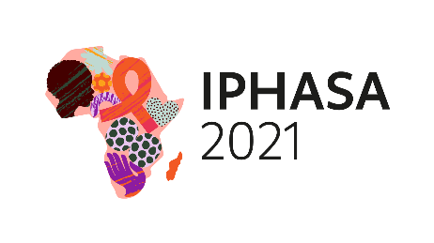
Early infant diagnosis uptake among HIV-exposed infants in Botswana, 2017– 2021
Obuile Makwati¹, Patrick Tema², Botshelo Kaisara², Kefilwe Gobeilweng², Balekane Sitibi², Chawapiwa Zwinila², Victor Omodi³, Lillian Okui³, Habib Omari⁴, Eldah Dintwa², Penny Makuruetsa²
1. South East DHMT, 2. Ministry of Health and Wellness 3. Maryland Global Initiatives Corporation, Botswana 4. University of Maryland School of Medicine, Institute of Human Virology, Baltimore, MD, USA
Background
The prevention of mother-to-child transmission (PMTCT) program was established in 1999 in Botswana.
The aim of the program is to improve child survival and development through reduction of HIV-related morbidity and mortality.
To track the effectiveness of the PMTCT program, early infant diagnosis (EID) was concurrently introduced.
All HIV-exposed infants should receive EID between 4 & 8 weeks postpartum according to the national program guidelines.
In this analysis, we characterize EID uptake among HIV-exposed infants in Botswana.
Results
Between 4 January 2017 and 27 June 2021, a total of 64,571 infants had their blood samples collected postpartum (Figure 1).
Of infants tested, 34,758 (53.8%) were tested within 4 to 8 weeks, which constitutes 66% of the EID uptake.
Three hundred and twelve babies had missing test results and 34,446 (99.1%) had their test results returned at 8 weeks or earlier postpartum.
Of those with documented test results, 181 (0.5%) were positive, 34,167 (99.2%) were negative and 98 (0.3%) were indeterminate.
There was no statistically significant difference in positivity rates by year of HIV diagnosis, p>0.05 (Figure 2).
The median time from delivery to EID testing was 45 (IQR: 42 – 48) days.
The median time from sample collection to EID testing was 13 (IQR:8–21) days.
Methods
This was a descriptive study using routinely collected EID data from the National Data Warehouse.
Median and interquartile range (IQR) were used to present continuous data.
Categorical variables were presented with proportions.
Trend analysis was done to assess HIV positivity rates by year of HIV diagnosis.
64,571
infants with blood samples collected
34,758
infants tested within 4-8 weeks of delivery
34,446
infants with test results returned within 8 weeks postpartum
Figure 2. HIV early infant diagnosis positivity by year, January 2017-June 2021 (N=34,446 infants)
181
infants tested positive for HIV
34,167
infants tested negative for HIV
Conclusion
Although the EID uptake is promising, nearly 50% of the infants were tested beyond the recommended duration.
Interventions to improve timely testing and EID uptake need to be reinforced.
Figure 1. Early infant diagnosis cascade from infant HIV testing to test result.
PRESENTED AT IPHASA 2021 – the 1st International Paediatric HIV Symposium in Africa|17-18 November 2021

