Slide 1
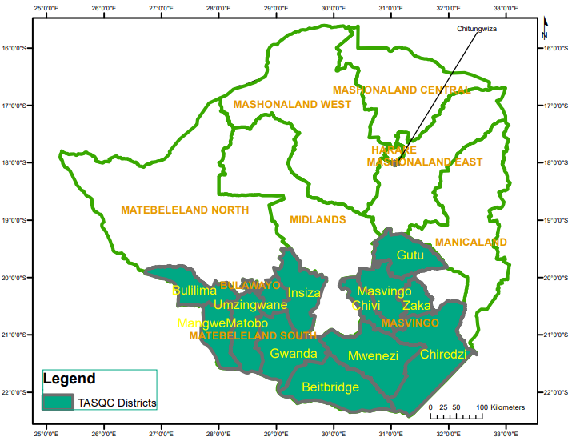
Are there missed opportunities for HIV testing among biological children of adult PLHIV in ART care in Zimbabwe?
Masiye, K¹, Webb, K¹ Takarinda, K¹, Nyathi, N¹, Shoko, O¹, Khumalo, P¹, Dhodho, E¹.
¹Organization for Public Health Interventions and Development, Harare, Zimbabwe
²Ministry of Health and Child Care, Harare, Zimbabwe
BACKGROUND
RESULTS continued
It is estimated that up to 40% of HIV infected children below the age of 19 years are currently undiagnosed.¹
Uptake of HIV testing in children over the age of 18 months is limited, creating a bottleneck for HIV treatment expansion and attainment of 95-95-95 goals in high burden countries.²
In Zimbabwe, where adult HIV prevalence is 12.8^{%3,} there is limited evidence on the proportion of children less than 19 years residing with an HIV positive biological parent who are aware of their HIV status.
From these 14 756 adults, a total of 25 238 children <19 years were identified. Among the children <19 years identified, more than a third (34%; n=8 581) were 5-9 years old.
The majority of biological children identified had a documented HIV status (65%; n=16 363).
Among these, 1 920 (12%) were HIV positive. The median age of HIV positive children was 7 years (IQR:6-8 ).
The majority of HIV positive children were documented as initiated on ART (97%; n=1 862).
Figure 1: OPHID TASQC Program Coverage
OPHID’s Target, Accelerate and Sustain Quality Care (TASQC) for HIV Epidemic Control supports HIV care and treatment programming in 317 health facilities and their surrounding communities in 4 provinces of Zimbabwe
OBJECTIVE
Our objective was to estimate the proportion of adults enrolled in HIV care with children less than 19 years with a documented HIV status.
Figure 3: HIV Testing Status of Children <19yrs Documented in the OI ART Care Booklet
METHODS
From December 2020 to January 2021, 26 high volume facilities serving 83 074 adult ART clients greater than 20 years were purposefully sampled in 3 districts of Zimbabwe.
48 995 (59%) of the adult HIV Care Booklets were consecutively selected over a period of a month and reviewed for documented HIV status of children <19 years. If data was missing on HIV status of children, a phone call was made to the biological parent on ART to provide HIV testing details of children.
Parents reporting unknown HIV test status of children were supported/requested to return to care for testing. Data was entered into Microsoft excel and analysed using STATAV13.
Of the 8875 who did not have documented HIV status in the OI ART Care booklet, 7 850 (88%) were successfully followed up and 79% (n=6208) knew their HIV status with 5% (n=338) being HIV positive and 99% (n=336) on ART.
RESULTS
Among the 48 995 adult HIV Care Booklets reviewed, the majority were female (n=30867; 63%).
14 756 (30.1%) adult clients in HIV care had documentation of having at least one biological child below the age of 19.
The majority of recipients of care with documentation of biological children in HIV care booklets were female (73%; n= 10772).
Figure 4: HIV Testing Status of those followed up by phone calls
CONCLUSIONS
Our findings indicate routine documentation of biological children among adults in HIV care is limited, particularly among men.
There are missed opportunities for HIV testing of biological children in more than 20% of children adults in ART care.
The OPHID Target Accelerate Sustain Quality Care (TASQC) programme has prioritized documentation of HIV test status of children <19 years of adults recipients of HIV care to improved targeted testing coverage in this sub-group.
REFERENCES
Cohn, J. et al (2016) 'Paediatric HIV testing beyond the context of prevention of mother-to-child transmission: a systematic review and meta-analysis', The Lancet HIV
Joint United Nations Programme on HIV/AIDS (UNAIDS). UNAIDS Data 2020. Geneva, Switzerland; 2020. National ART Guidelines
^{ZIMPHIA, 2020.}
Figure 2: ART Clients and ART Care Booklets Reviewed)
Acknowledgements: We gratefully acknowledge support from the President’s Emergency Plan for AIDS Relief (PEPFAR) through USAID to OPHID Target, Accelerate and Sustain Quality Care (TASQC) for HIV Epidemic Control: 72061320CA00005
For more information contact:
Organization for Public Health Interventions and Development
20 Cork Road, Belgravia, Harare, Zimbabwe
www.ophid.org; kmasiye@ophid.co.zw

